Slide 1
3D Augmented Reality Demo
Manisha Biswas

Slide 2
Unity
I have used Unity to create the experience
For Augmented Reality I have used Vuforia SDK
I have added the surface created a new App id

Slide 3
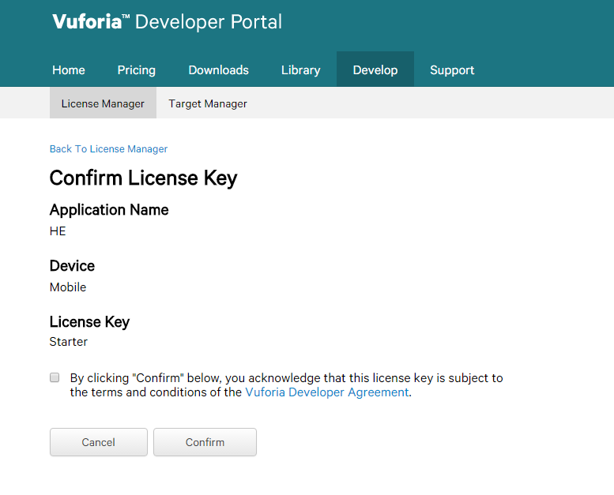
Vuforia Portal

Slide 4
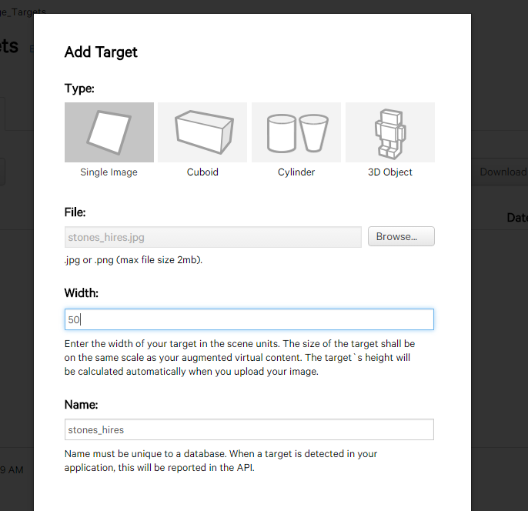
Adding the target

Slide 5
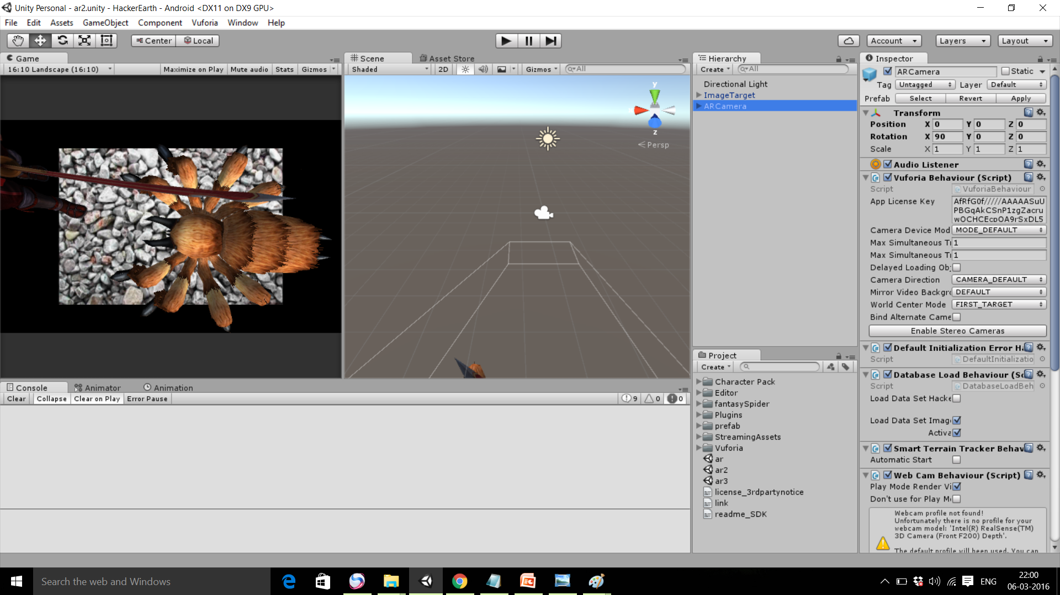
Creating the scene

Slide 6
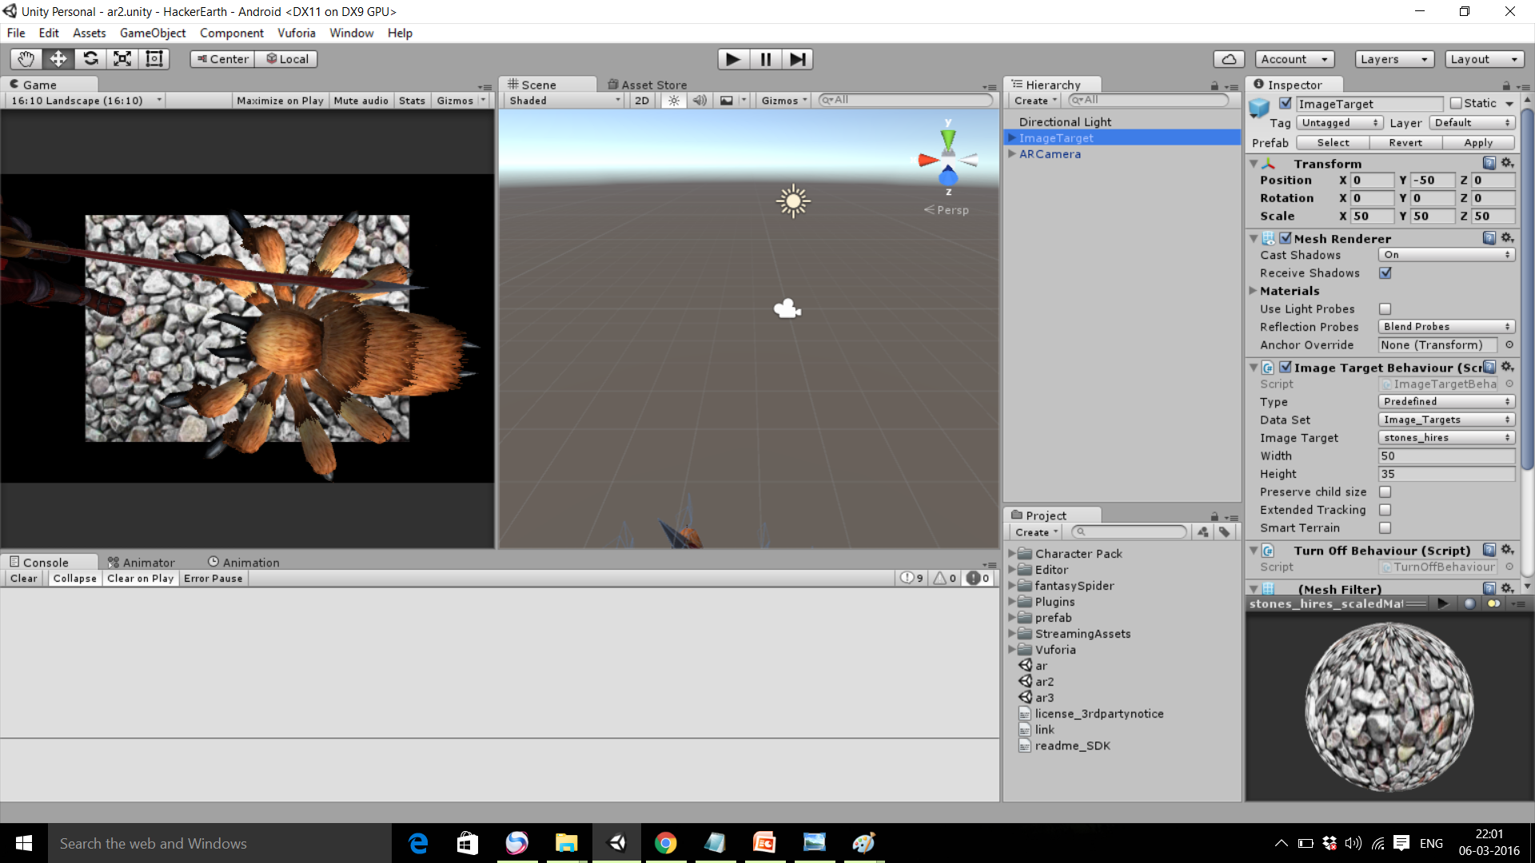

Slide 7
Compile and run the application
We get to see the application running in Android mobile

